Slide 1



PLEASE ATTACH THE LOGO OF YOUR AFFILIATION/S HERE
Presentation Title
FIRST AUTHOR1, SECOND AUTHOR1,2, AND THIRD AUTHOR3
1 AFFILIATION OF AUTHOR/S
2 AFFILIATION OF AUTHOR/S
3 AFFILIATION OF AUTHOR/S
INTERNATIONAL BIOLOGY CONFERENCE (IBOC), 25 OCTOBER 2023

Slide 2
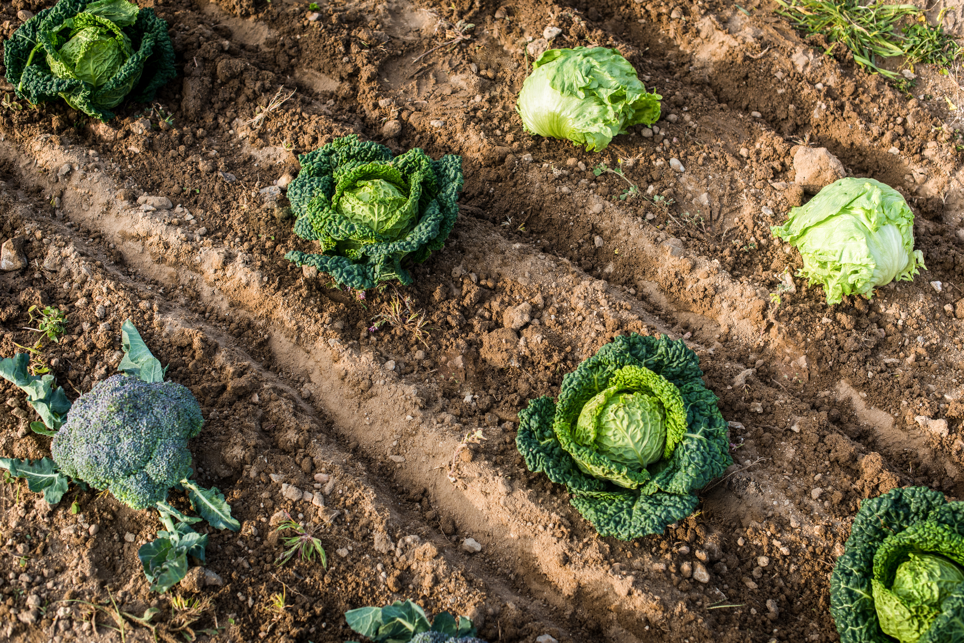
PLEASE ATTACH THE LOGO OF YOUR AFFILIATION/S HERE
Introduction
  The introduction should be prepared only in 1 slide
  Clearly state the problem formulation of the study
  Clearly state the related previous studies
  Clearly state the gap and the novelty of the study
  Clearly present the objective of the study
INTERNATIONAL BIOLOGY CONFERENCE (IBOC), 25 OCTOBER 2023

Slide 3
PLEASE ATTACH THE LOGO OF YOUR AFFILIATION/S HERE
Materials and Methods
  The Materials and method should be prepared only within 1-2 slides
  Consider providing flow charts to explain the methods
  Consider using figures to present materials or map to explain the research location
  Use past tense
INTERNATIONAL BIOLOGY CONFERENCE (IBOC), 25 OCTOBER 2023

Slide 4
PLEASE ATTACH THE LOGO OF YOUR AFFILIATION/S HERE
Results and Discussion
  The Results and Discussion should be prepared only within 2-4 slides
  Present the findings (data) in Figures and Tables including the statistical analysis
  Each Figure or Table should be given a name
  Figure captions are placed below the figure, while Table captions are placed above
  Explain the meaning of the results
  State the particular cause of the results
  State clearly the significance of the findings
  Use past tense
INTERNATIONAL BIOLOGY CONFERENCE (IBOC), 25 OCTOBER 2023

Slide 5
PLEASE ATTACH THE LOGO OF YOUR AFFILIATION/S HERE
Consclusion
  The conclusion should be prepared only within 1 slide
  Summarize the main finding by referring to the objective of your study
  Use simple words to emphasize your main finding, avoid statistical statements
  Present the possible future works, if any
INTERNATIONAL BIOLOGY CONFERENCE (IBOC), 25 OCTOBER 2023

Slide 6
PLEASE ATTACH THE LOGO OF YOUR AFFILIATION/S HERE
References
  Provide references you cited to prepare this presentation
INTERNATIONAL BIOLOGY CONFERENCE (IBOC), 25 OCTOBER 2023

Slide 7
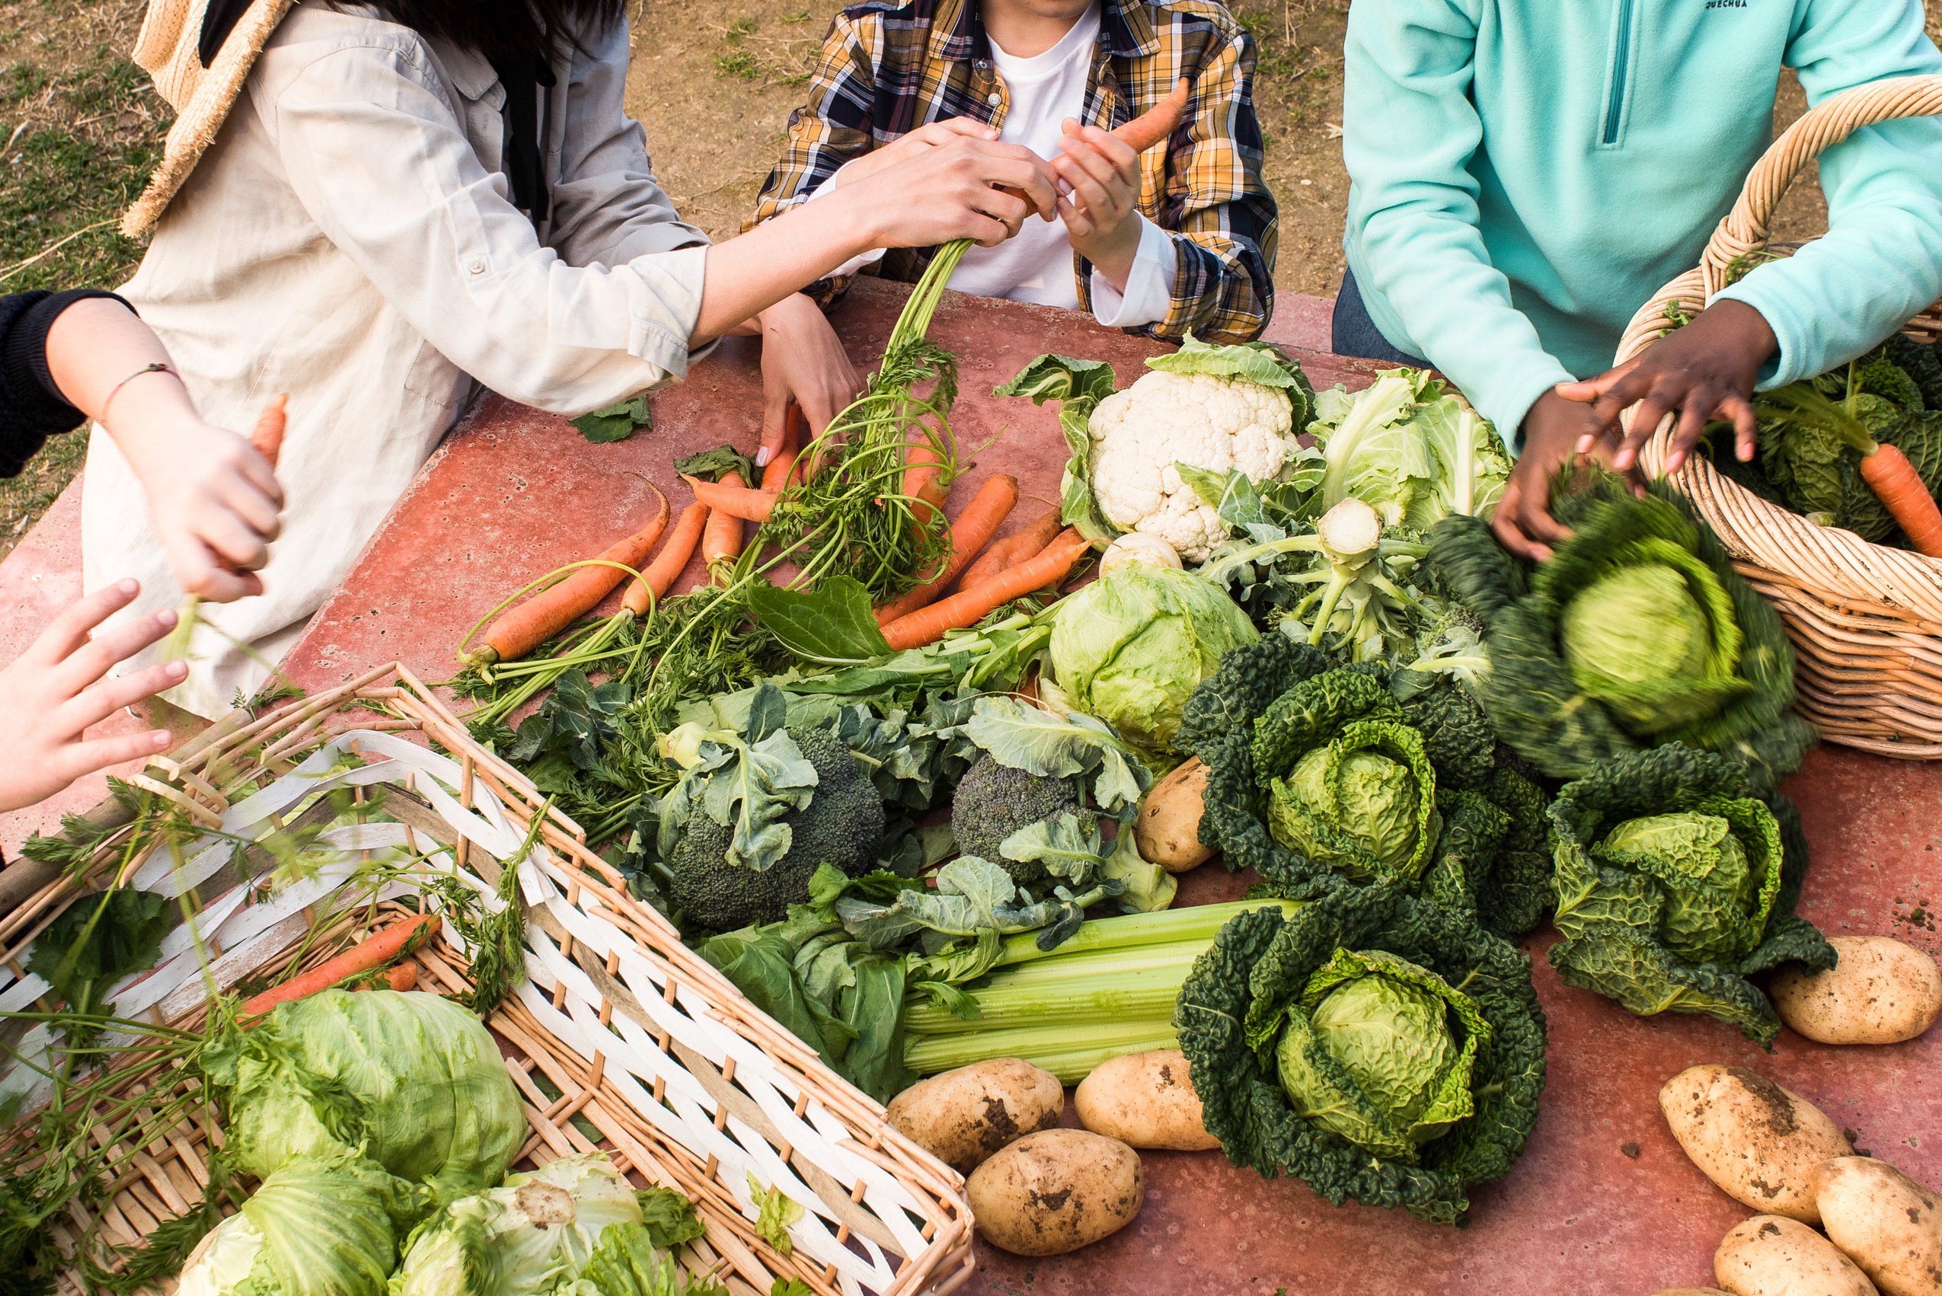
PLEASE ATTACH THE LOGO OF YOUR AFFILIATION/S HERE
Others
  Please use formal and correct English
  Avoid overload of images and text
  You can use another template or background as you prefer to make it more attractive
  Avoid too much animation
INTERNATIONAL BIOLOGY CONFERENCE (IBOC), 25 OCTOBER 2023

Slide 8
PLEASE ATTACH THE LOGO OF YOUR AFFILIATION/S HERE
Thank You
INTERNATIONAL BIOLOGY CONFERENCE (IBOC), 25 OCTOBER 2023

